Slide 1
Azure + Power BI
Lucas Cosas
12/11/2019

Slide 2




Agenda
Introdução
Overview Azure
Overview Power BI
QnA

Slide 3
Azure Cloud
Microsoft Azure

Slide 4

O que é a nuvem?
O que é a nuvem, de vdd?
\kloud\ noun
a prática de “guardar” dados e poder computacional em servidores que podem ser acessados pela internet
uma forma poderosa de transformar seus negócios
Notes:
What is the cloud?
What is the cloud? [go through the definition]
But what is the cloud, really? [read the blurb]
The cloud isn’t just about bits and bytes, it’s a mindset--it’s a way of transforming your business

Slide 5
O que é Azure?
Edge Devices
Azure Stack
Azure Data Box
Azure Sphere
Azure Kinect
HoloLens
Serverless
Web
Mobile
Mixed Reality
Containers
Events + Integration
Databases
Analytics
AI + Machine Learning
Internet of Things
Media
Tools
Visual Studio
GitHub
PowerApps
Power BI
Infrastructure
Compute
Networking
Storage
Security
Identity
Notes:
Now, if you haven’t looked at Azure in a few months, you may be surprised to see what we have these days.
This is the high-level map of the class of services that we offer. We have well over 200 services and capabilities.
You’ll notice we’ve extended to the edge. The ability to run application code in the cloud but also in that seamless, consistent way in the edge is informing our edge investments, whether it be Azure Stack, Azure Sphere, all the way to the Hololens and our Mixed Reality capabilities – these are powerful Edge devices that work in connection with the cloud.
You’ll see we have dev tools, devOps and great innovation, to the core infrastructure and PaaS services that we offer.
TRANSITION: Overall, this gives you the scope of what Azure as a platform and service can do for you.

Slide 6
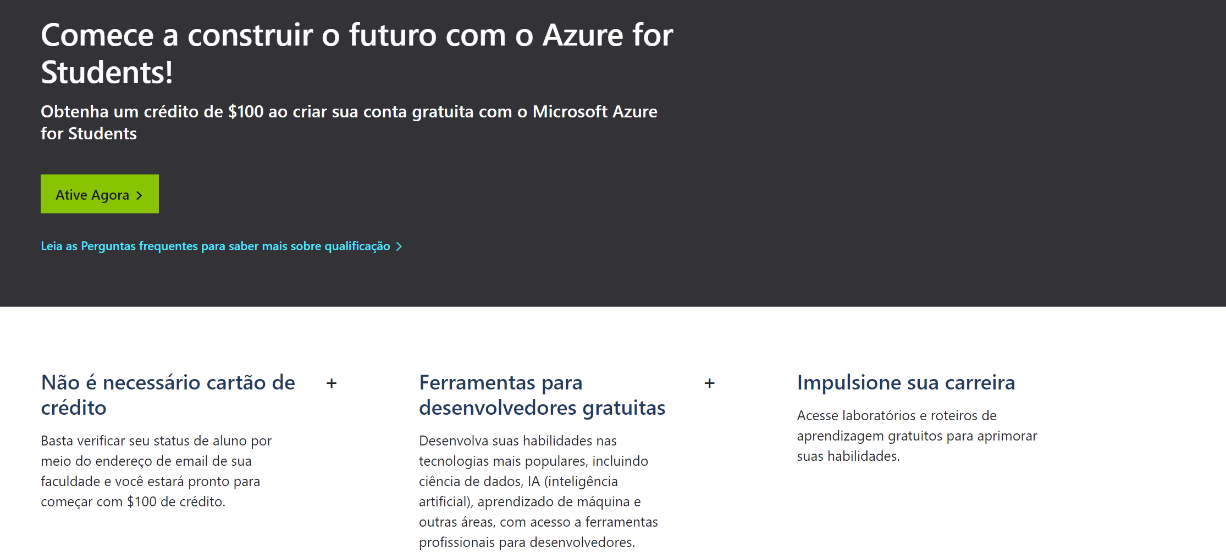
https://azure.microsoft.com/pt-br/free/students/

Slide 7
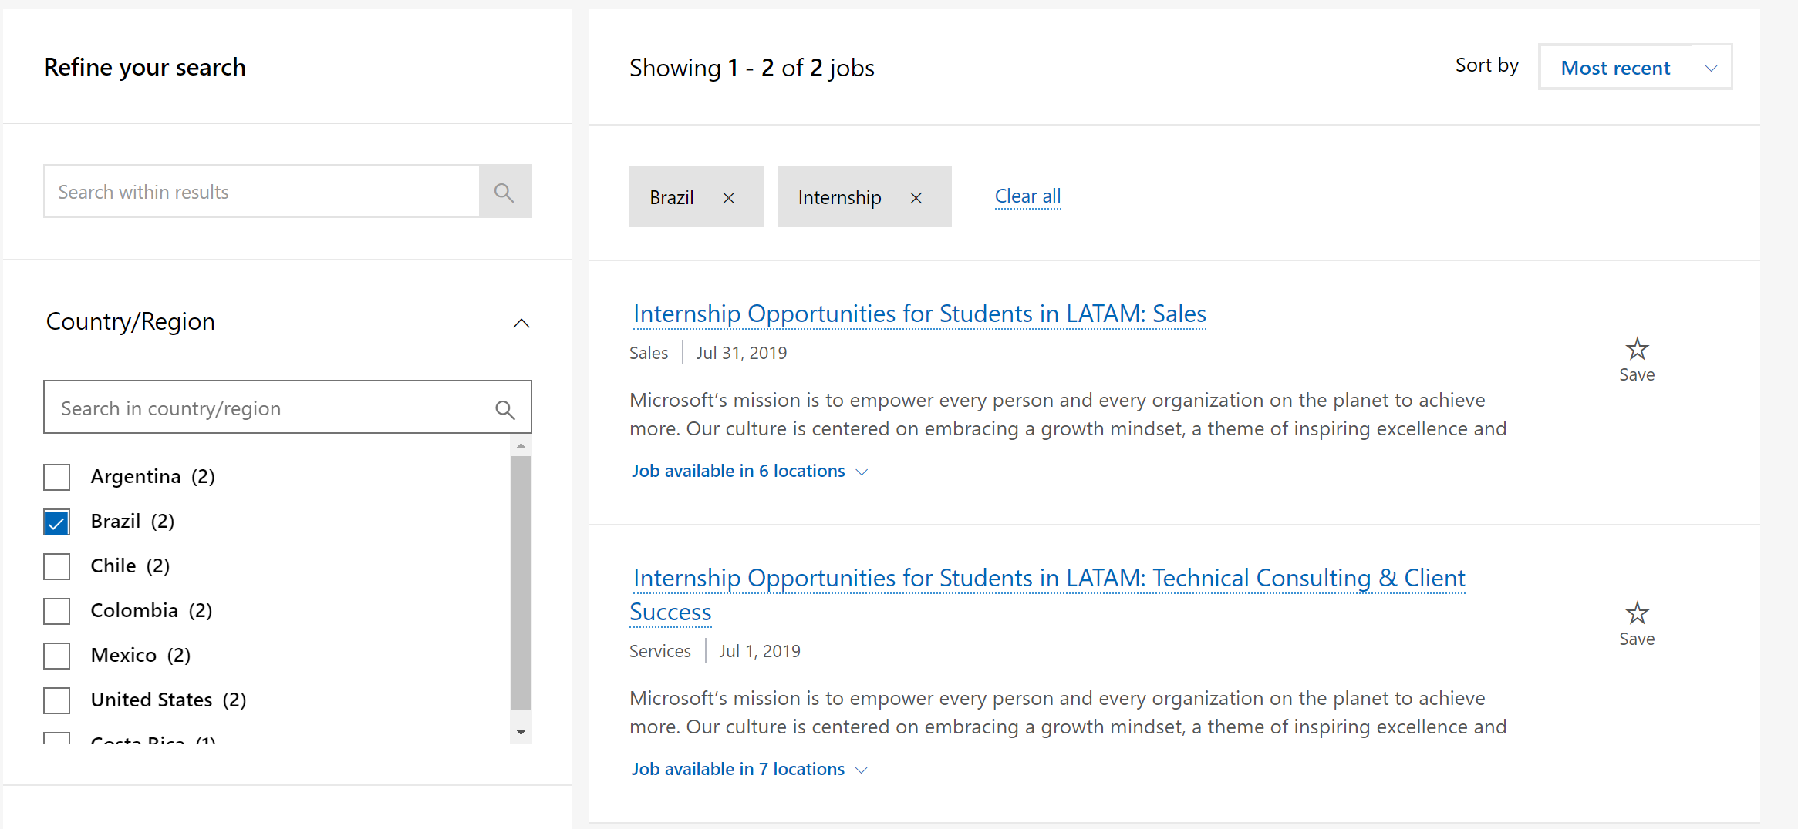
https://careers.microsoft.com/students/us/en/br-ur-intern-results

Slide 8
I’ve got the Power
Overview Power BI

Slide 9
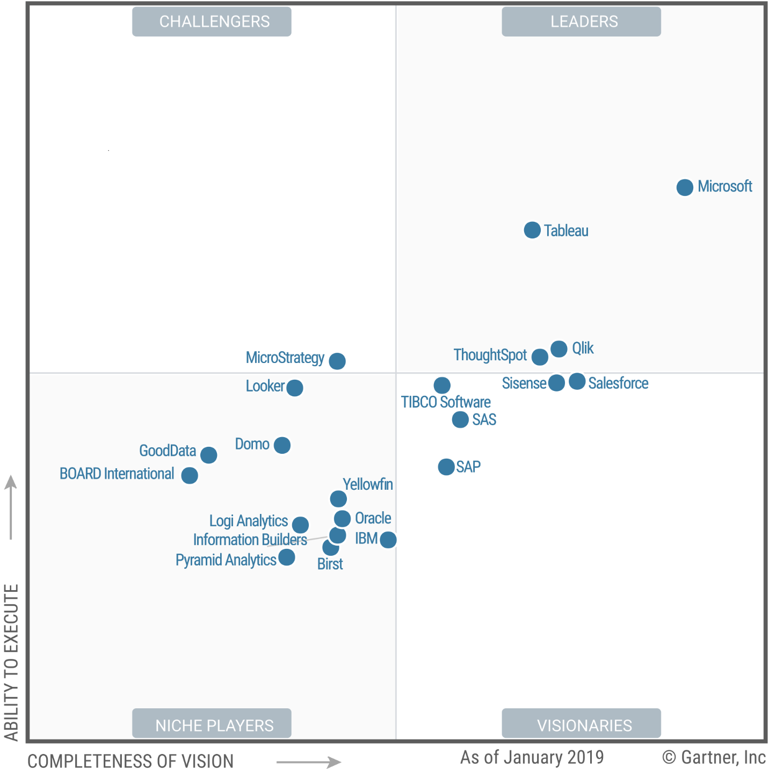

Since February 2018
A Leader in
Analytics & BI Platforms*
*Gartner “Magic Quadrant for Analytics and Business Intelligence Platforms,” by Cindi Howson, Rita L. Sallam, James Laurence Richardson, Joao Tapadinhas, Carlie J. Idoine, Alys Woodward, February 2018
The above graphics were published by Gartner, Inc. as part of a larger research document and should be evaluated in the context of the entire document. The Gartner document is available upon request from Microsoft. Gartner does not endorse any vendor, product or service depicted in its research publications, and does not advise technology users to select only those vendors with the highest ratings or other designation. Gartner research publications consist of the opinions of Gartner's research organization and should not be construed as statements of fact. Gartner disclaims all warranties, expressed or implied, with respect to this research, including any warranties of merchantability or fitness for a particular purpose.

Slide 10

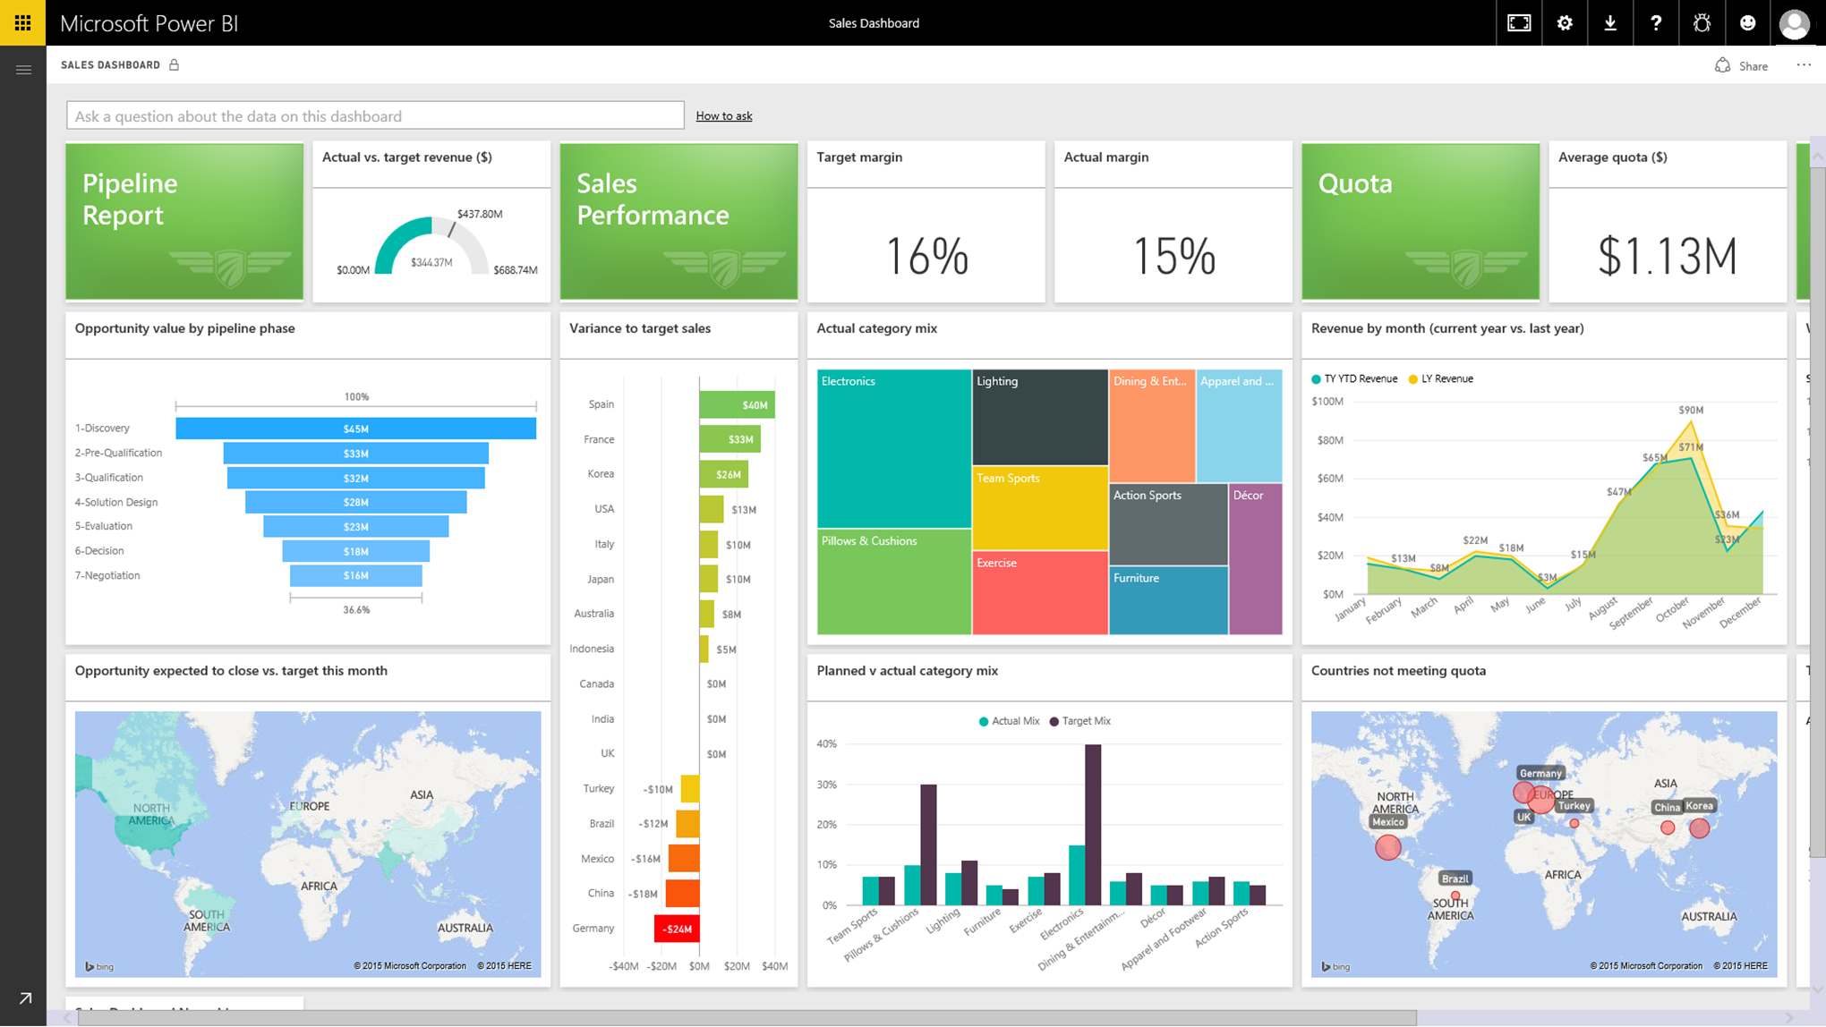


Support hybrid data
LIVE POWER BI REPORTS & DASHBOARDS
LIVE POWER BI REPORTS & DASHBOARDS
Gateway Cloud Service
Data source connection credentials are encrypted
Cloud
Power BI reports
Cloud
SSRS reports
Custom
Visualizations
Azure Service Bus
LIVE CONNECTION OR SCHEDULED REFRESH
LIVE CONNECTION OR SCHEDULED REFRESH
On-premises
Power BI Report Server
Application Gateway
Data source connection credentials can only be decrypted by the gateway
On-premises
SSAS tabular /
multidimensional model
Data source
SSAS tabular/
multidimensional model
Data source
Notes:
Access on-premises data any way you like
Connect to on-premises SSAS models

Slide 11


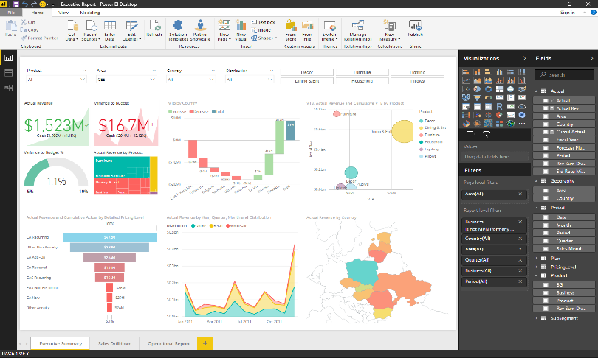




Transforming with data: the Business Analyst role
Get Data
Analyze
Visualize
Visualize
Power BI Desktop is a free companion authoring tool for the Power BI service, updated monthly with new features
Publish
Collaborate

Slide 12

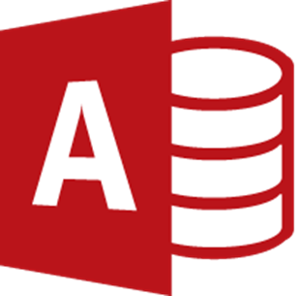


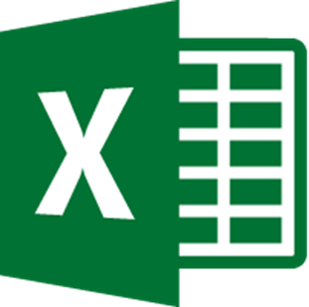
















Get Data: Easily connect, clean, and mashup data
Connect to 80+ data sources, both on-premises and cloud
Shape, transform, and clean data for analysis
Live connectivity to on-premises and cloud data sources
Extend with custom data connectors for any data source

Slide 13
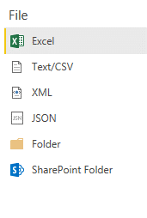
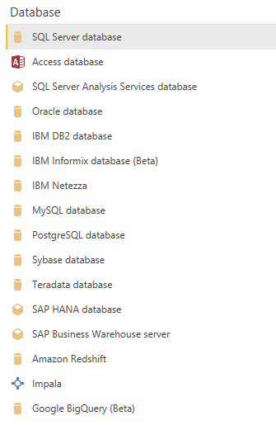
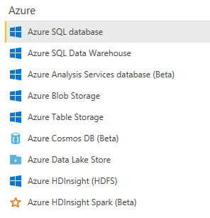
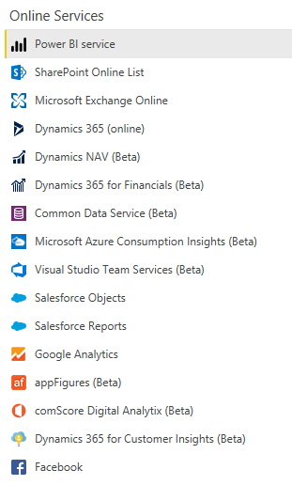
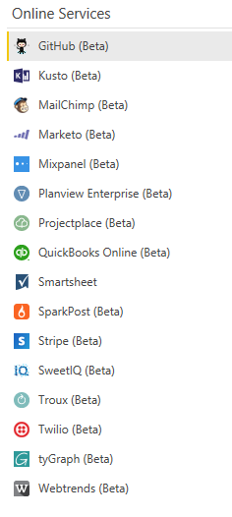
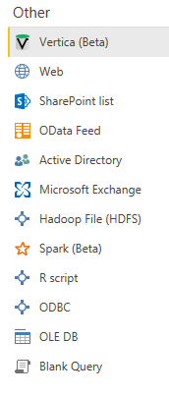
Power BI Desktop Data sources Over 80+ data sources and growing
Notes:
Consolidate data from a broad range of sources
Key message:
Power BI Desktop allows you to connect to data sources beyond what powerbi.com supports – constantly working and adding new data sources
For more information visit: https://powerbi.microsoft.com/en-us/documentation/powerbi-desktop-data-sources/

Slide 14
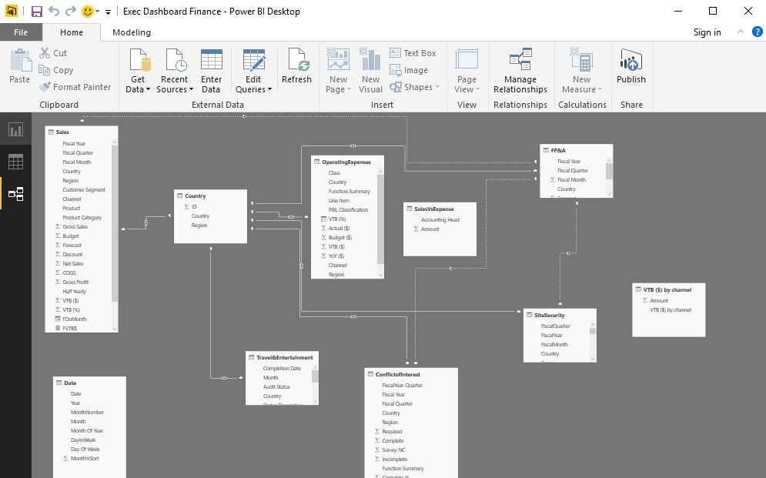
Analyze: Build powerful models and flexible measures
Automatically created model when connecting to data
High-performance, in-memory engine
Point and click analysis with Quick Measures, Clustering and Binning
Create powerful measures with familiar DAX formulas

Slide 15

Visualize: Create stunning interactive reports
Author reports using 150+ visuals via a drag-and-drop canvas
Explore data across multiple interactive visualizations
Provide insights in the context of your business with Custom Visuals
Visualize your data story with bookmarks and custom navigation

Slide 16
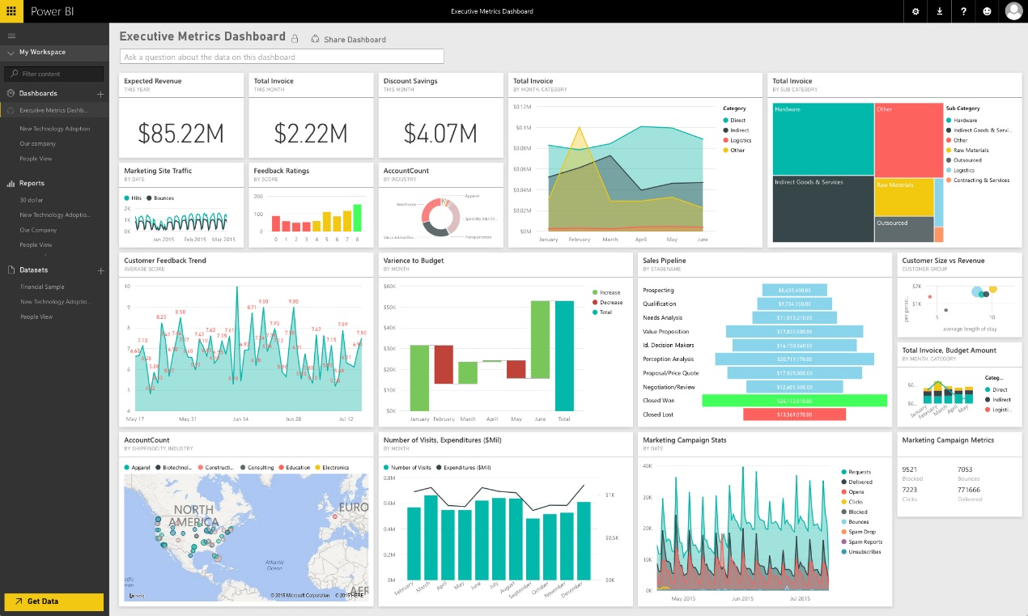
Publish: Share insights with others
Publish directly to the cloud or on-premises
Automatic data refresh, so your reports are always up to date
Package your reports in apps for easy consumption and control
Manage your analytics content with admin and governance tools

Slide 17
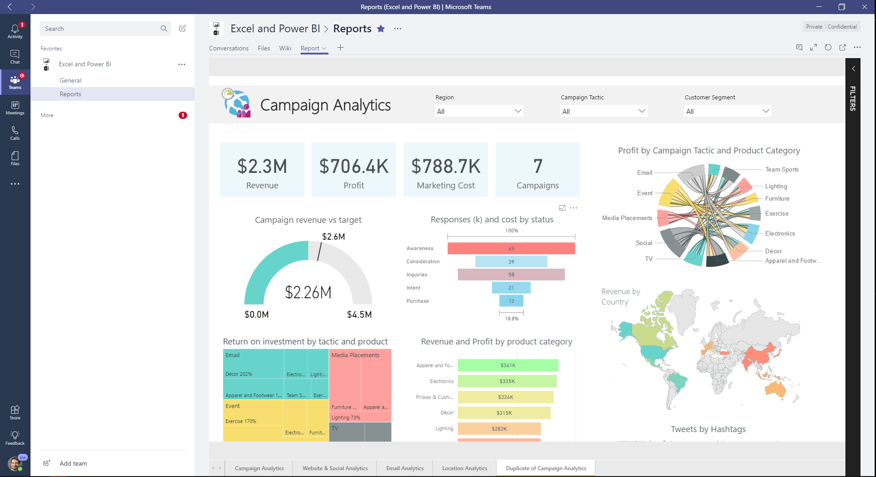





Collaborate: Empower your organization
Provide access to reports and dashboards anywhere on any device
Enable users to Ask questions and automatically discover insights from the data
Deliver insights through other services such as Sharepoint and Teams
Connect live to your models in Excel and Power BI Desktop

Slide 18
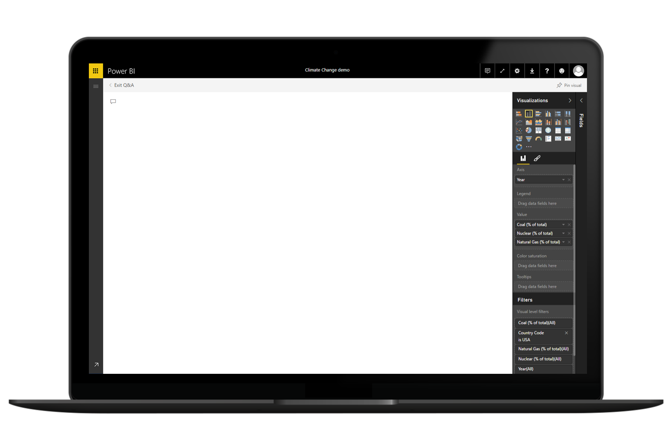
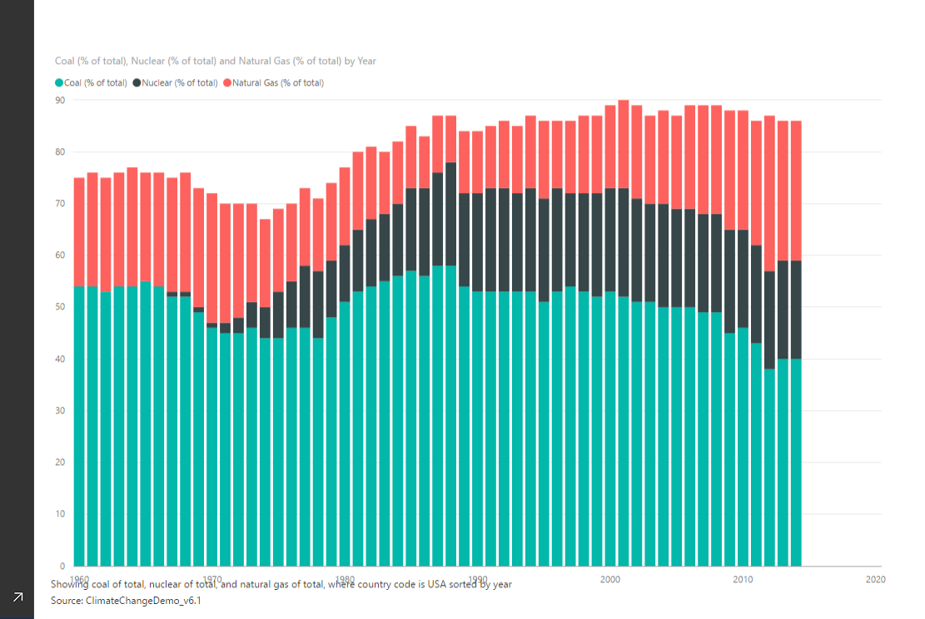
Eletricidade por Gás, Nuclear e Carvão por ano nos EUA
Ask questions of your data

Slide 19
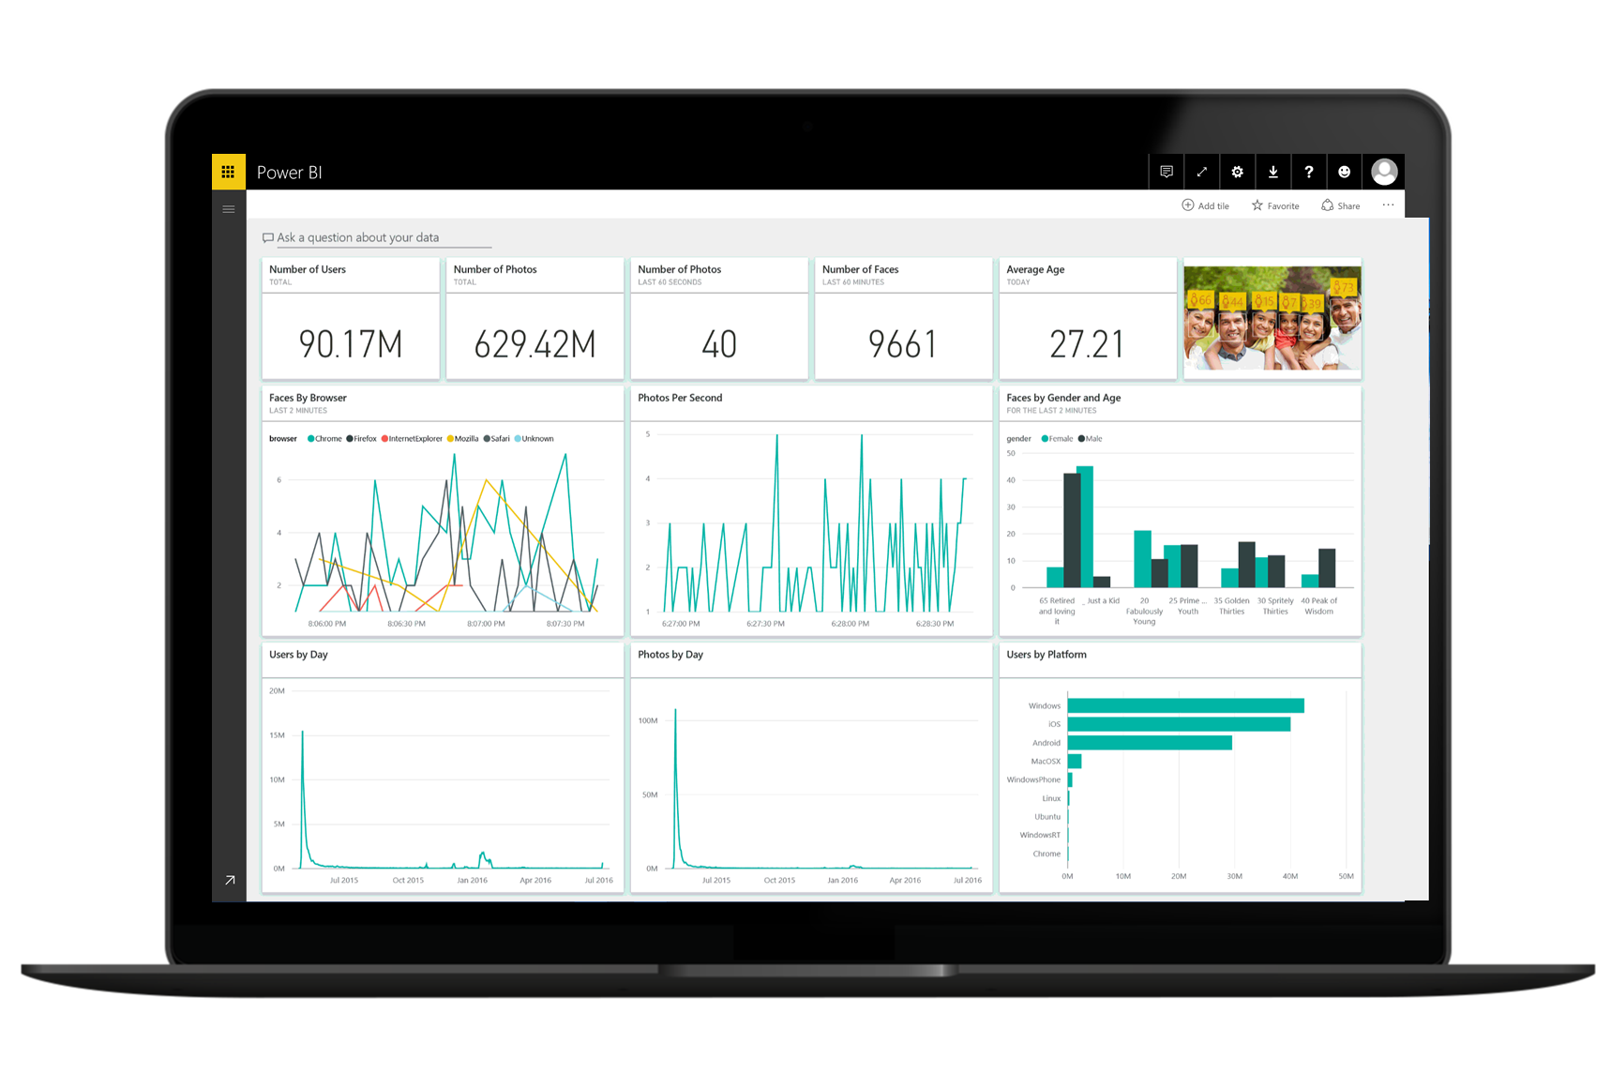
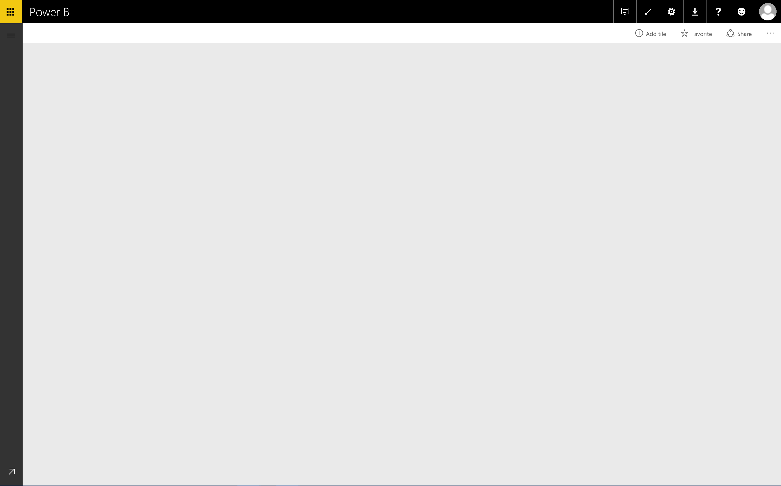
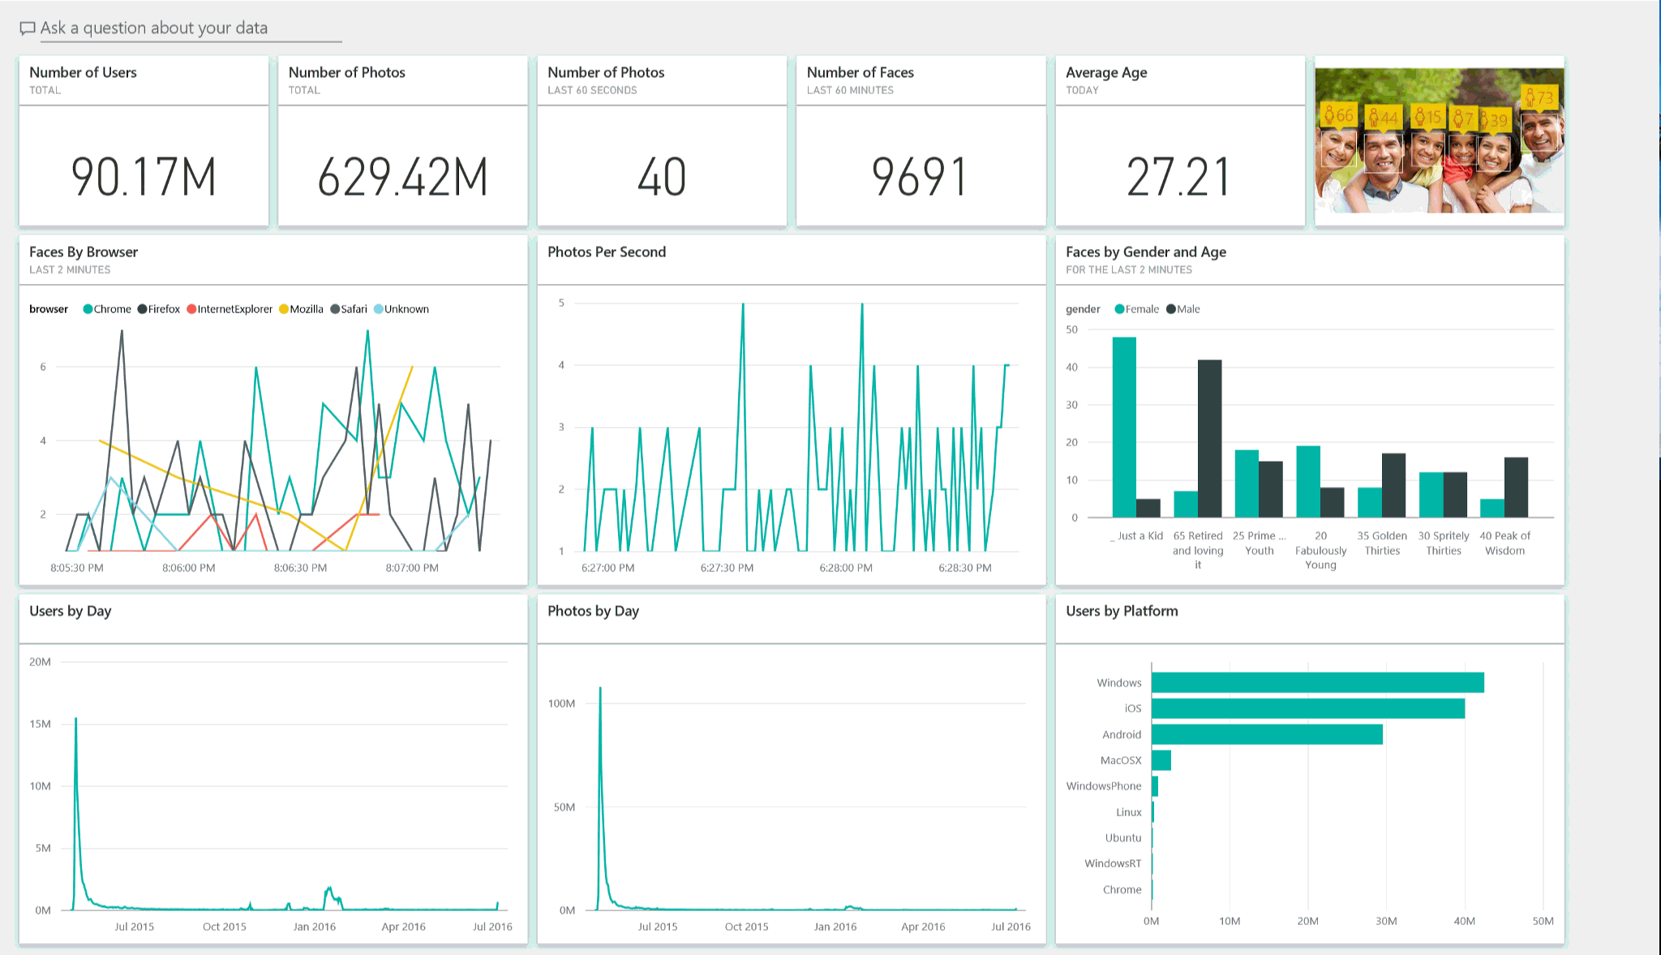
Run your business in real time with live dashboards

Slide 20
Power BI product portfolio
Author
Share and collaborate
Large scale deployments
App dev
</>
Power BI
Desktop
Power BI
Pro
Power BI
Premium
Power BI Embedded
Licensed by User
Licensed by User
Licensed by Capacity
Licensed by Capacity
Free data analysis and report authoring tool
Quick, easy-to-use self-service analytics for users requiring collaboration, dashboard sharing, ad hoc analysis, and report publishing
Dedicated capacity for increased performance of Pro Licenses
Visual analytics embedded in your applications
Notes:
Power BI Desktop - A free tool to download to create and author modern and interactive reports
Power BI - A SaaS service to share, collaborate reports & Dashboard and gain insight from your data
Power BI Premium - Add-on dedicated capacity to the Power BI SaaS service
Power BI Report Server – On-premises report server
Power BI Embedded - Power BI Embedded analytics APIs for ISVs and Developers

Slide 21
Demonstração
https://github.com/LucasCosas/Power_BI/blob/master/Demo%20Excel/Roteiro.md

Slide 22
Q&A
Obrigado!
Lucas Cosas
Cloud Solutions Architect – Data and AI
lucosas@microsoft.com
in/lucas-cosas

